Slide 1
Tutoring Center Management System

Slide 2
Presented by
Name | ID
Md. Rahat Bin Israil | 22234103139
Md. Shahidul Islam Parvez | 22234103123
Md. Noor Uddin Yousuf Shanto | 22234103136
Akkas Uddin Akash | 22234103137
Fahim Sahriar | 22234103151

Slide 3
Introduction
This Presentation details the design and implementation of a database for a Tutoring Center Management System (TCMS). The TCMS aims to streamline and automate various administrative and operational tasks within a tutoring center, enhancing efficiency and providing a better experience for students.

Slide 4
Motivation
Traditional methods of managing tutoring centers often involve manual processes, which are not only time-consuming but also errors and inconsistencies The motivation behind TCMS is to enhance the efficiency and effectiveness of educational delivery. By leveraging technology, the system aims to streamline administrative tasks, improve student engagement, and learning environments. improve the overall effectiveness of tutoring services.

Slide 5
Objective
Our goal is to develop a comprehensive Tutoring Center Management System that simplifies administrative tasks, improves communication, and enhances the overall efficiency of tutoring centers.
Outline the specific objectives such as:
Streamlining course offering.
Managing student information.
Manage course & see details.
Generating student reports for analysis and decision-making.

Slide 6
Features
Student Management :
Registration:
Add new students with personal details (name, address, contact information, gender, etc.).
Store student records securely.
Manage Student:
Update student information.
Search and filter students based on criteria like Address, Name.
Print:
Print student information reports.

Slide 7
Course and Teacher Management :
Registered Courses:
Add new courses with details (name, description, duration, teacher, etc.).
Assign tutors to specific courses.
Associate students with specific courses.
Manage Courses:
Update course details.
Search and filter for courses by course name or student name.
View and manage course.
Print:
Generate course reports with details, including enrolled students and assigned tutors and courses.

Slide 8
Score Management :
New Score:
Record student scores for specific courses.
Associate scores with student ID and course details.
Add score description (e.g., A+, Very Good).
Manage Score:
Update score details.
Search and filter scores by Name or course name.
Print:
Generate comprehensive student result reports, scores and overall performance.

Slide 9
Dashboard :
Student Statistics:
Display the total number of students enrolled.
Show student gender distribution (male/female).
Course Enrollment Trends:
Track the number of students enrolled in each course.
Exit :
Allow users to exit the application securely.

Slide 10
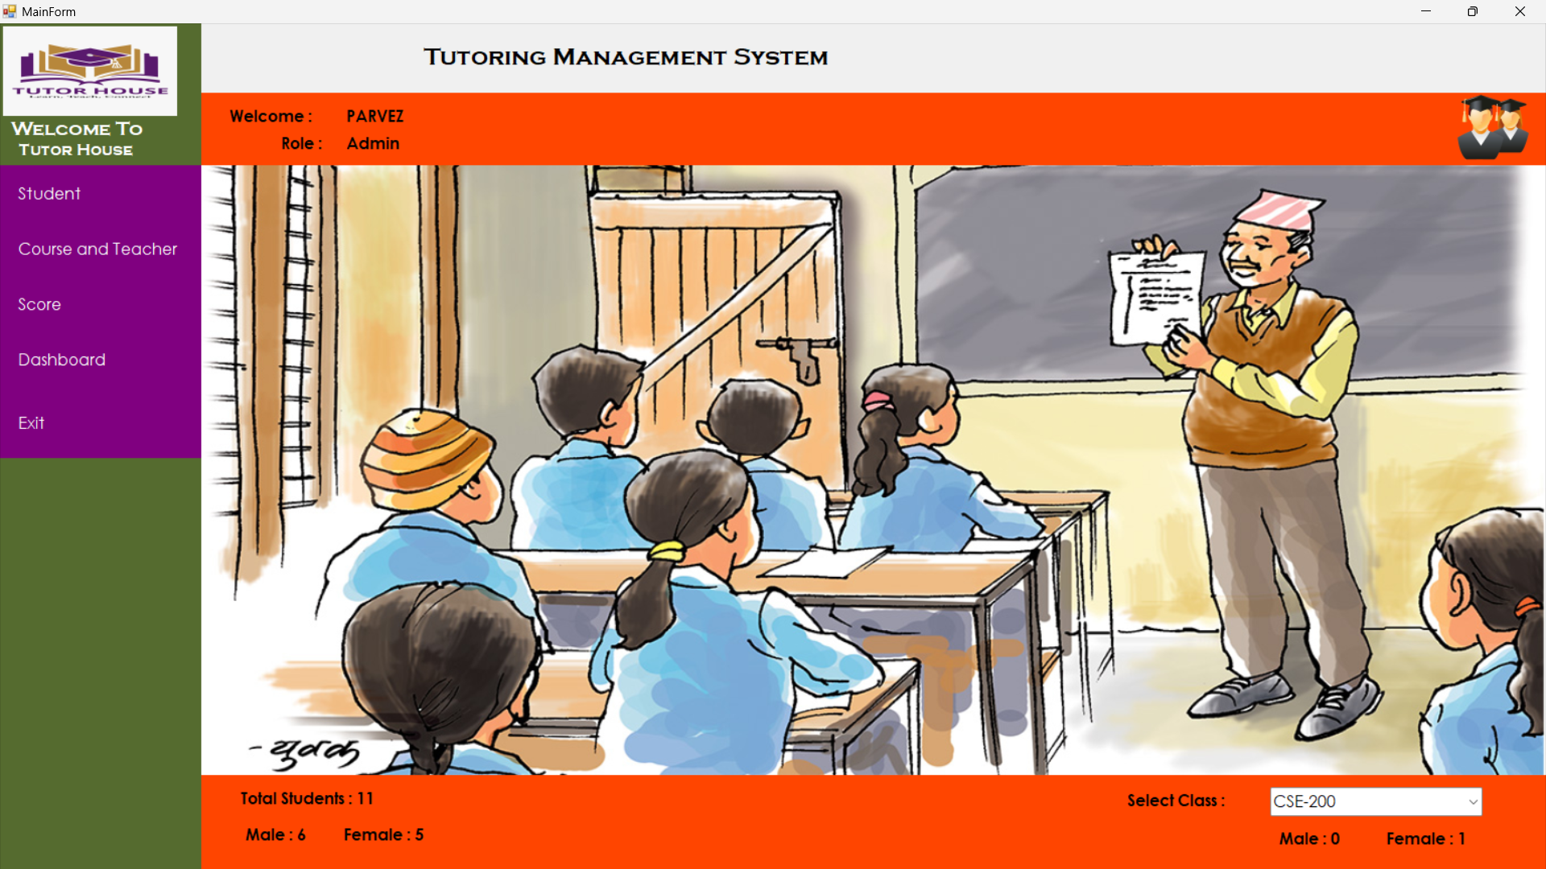
INTERFACES
Dashboard

Slide 11
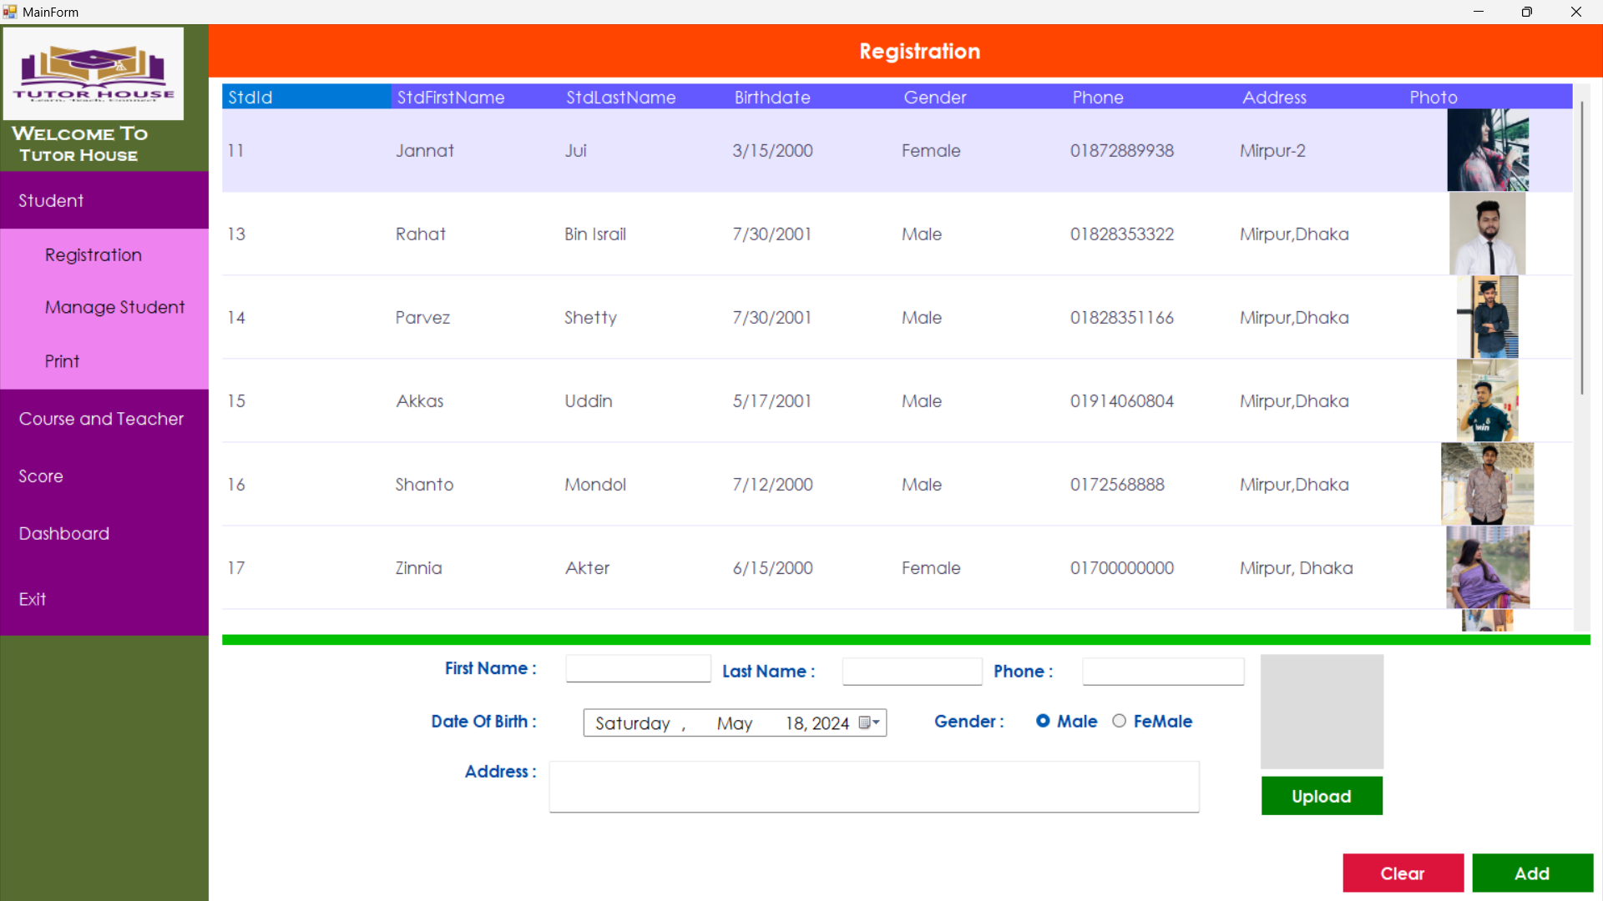
Registration

Slide 12
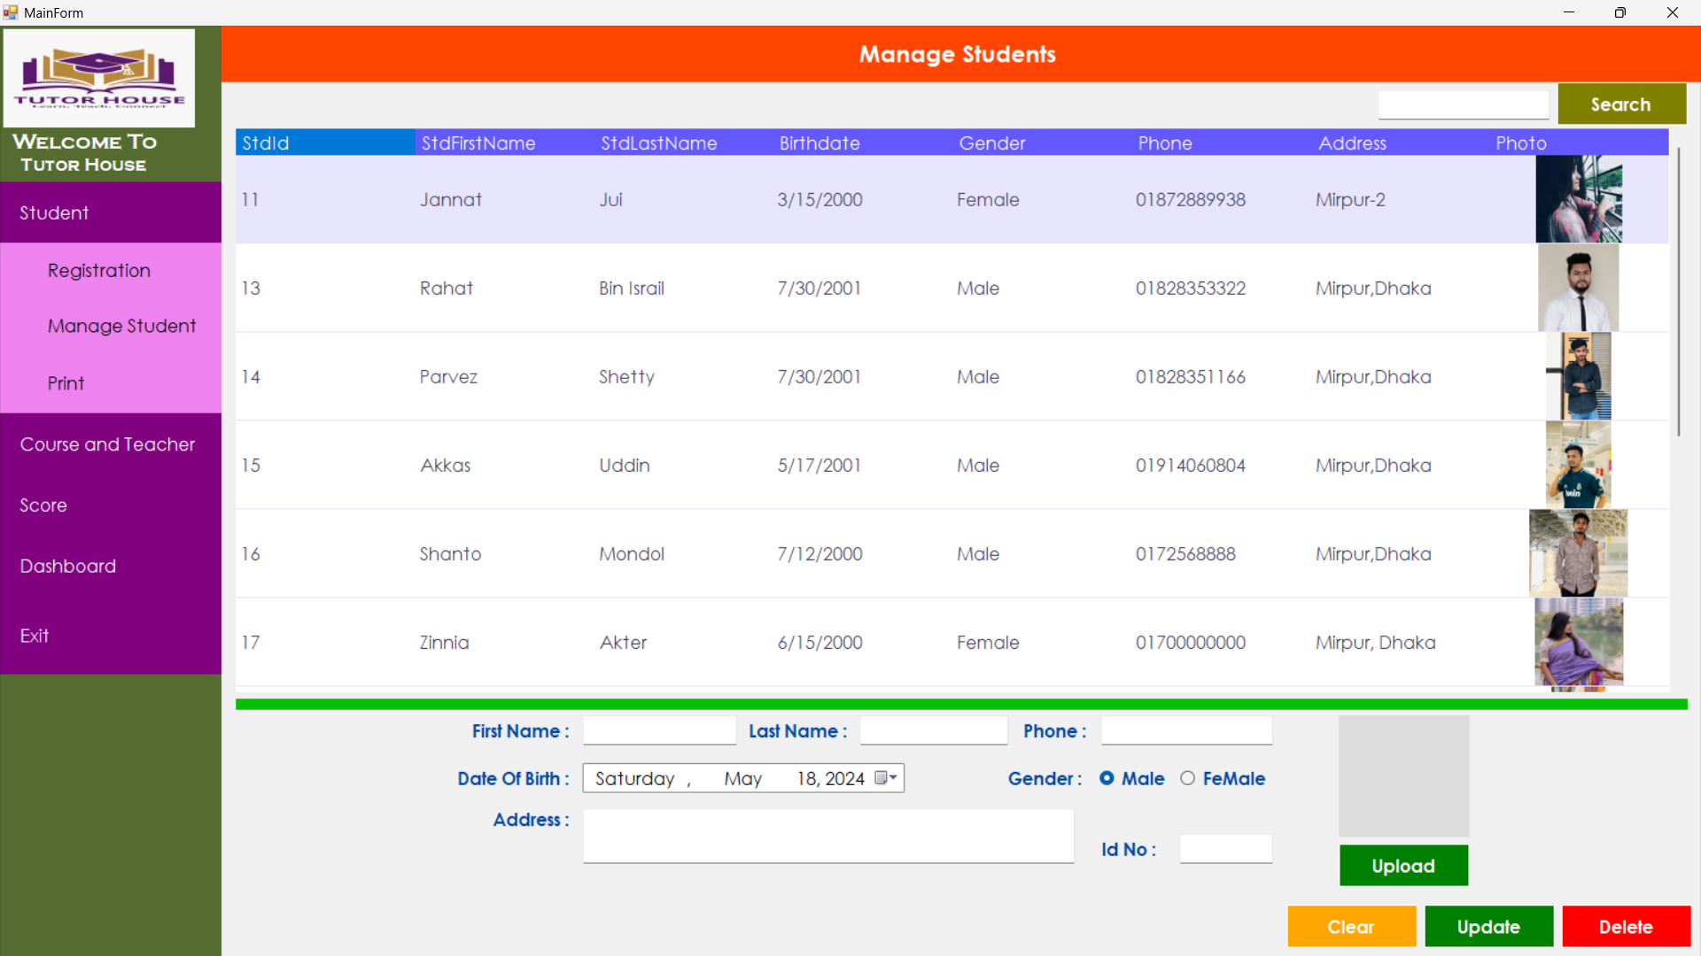
Manage Students

Slide 13
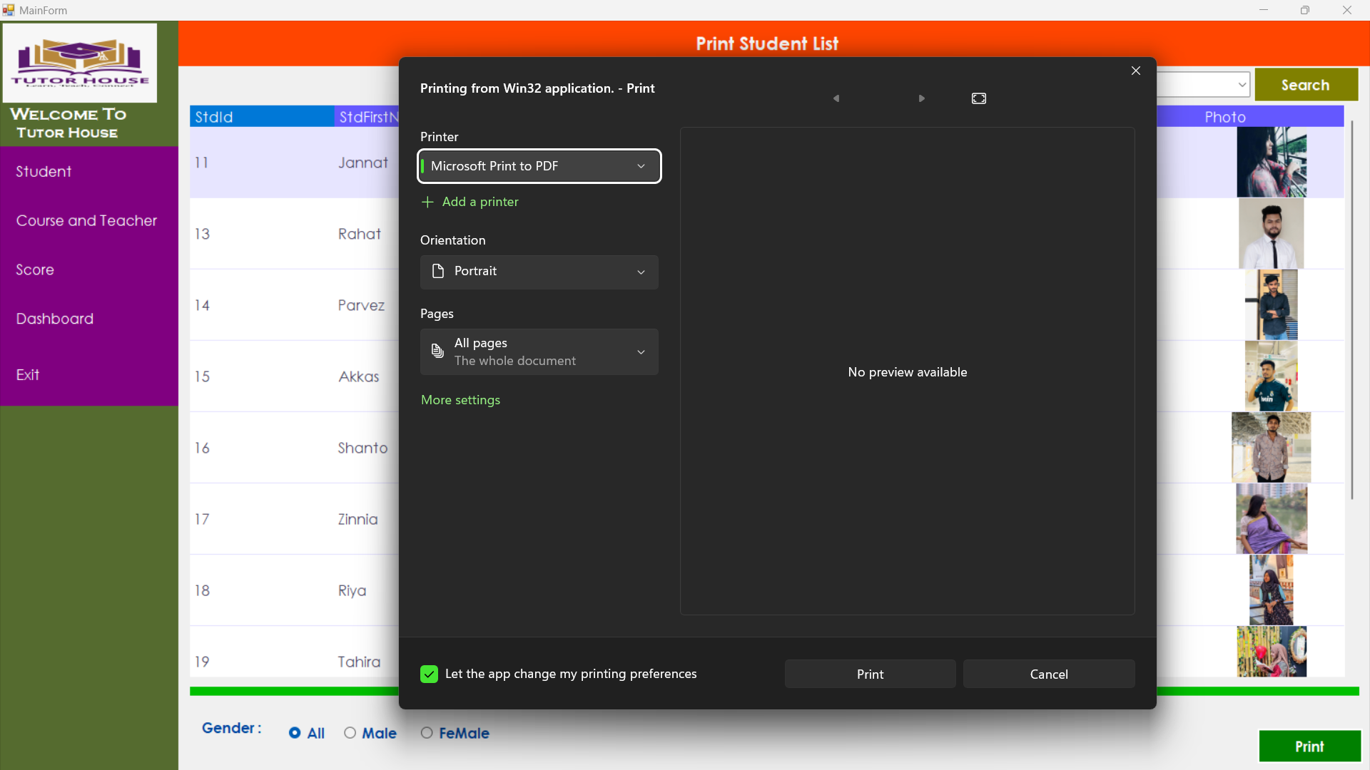
Print Student List

Slide 14
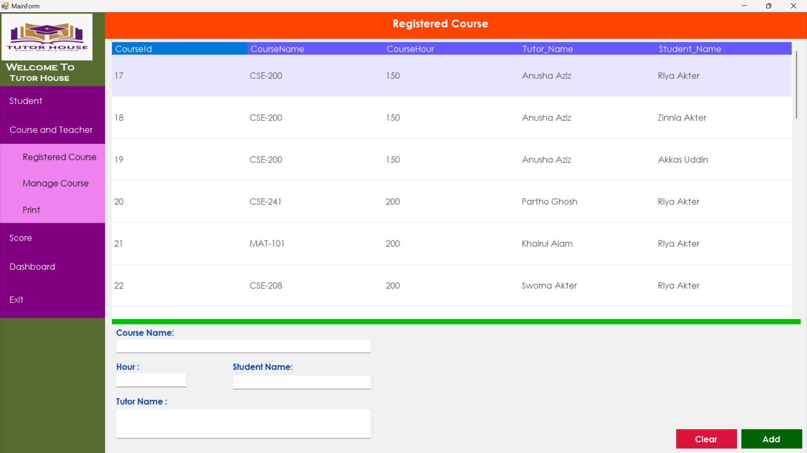
Registered Course

Slide 15
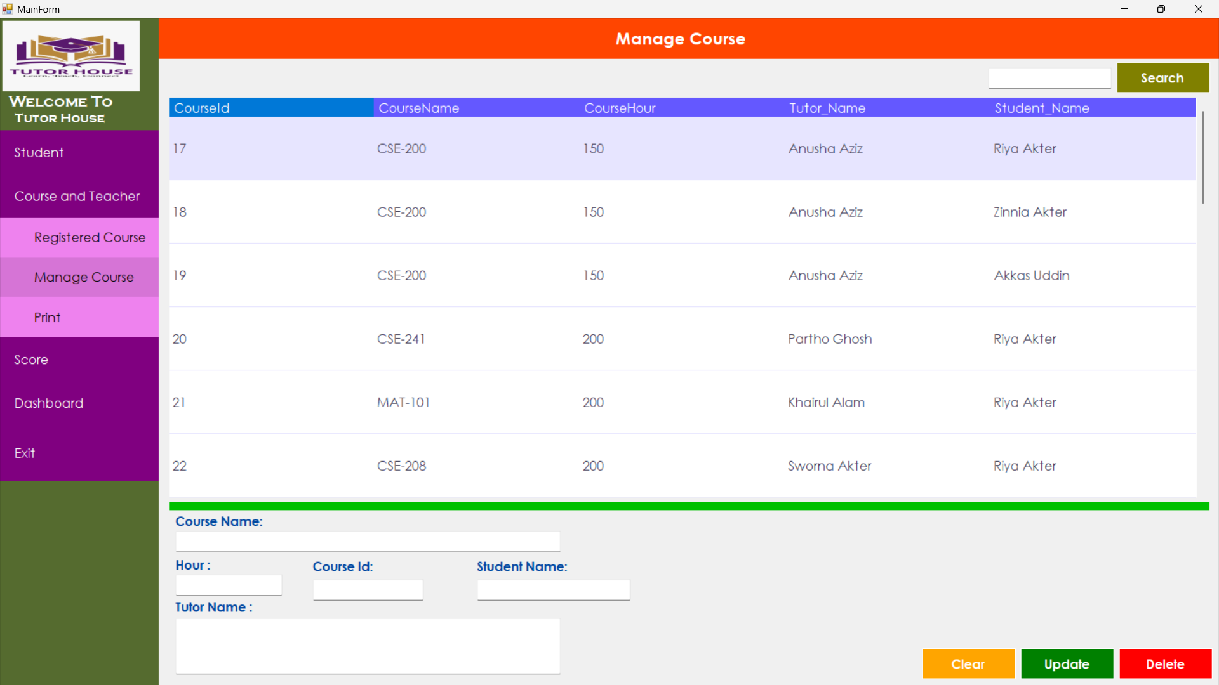
Manage Course

Slide 16
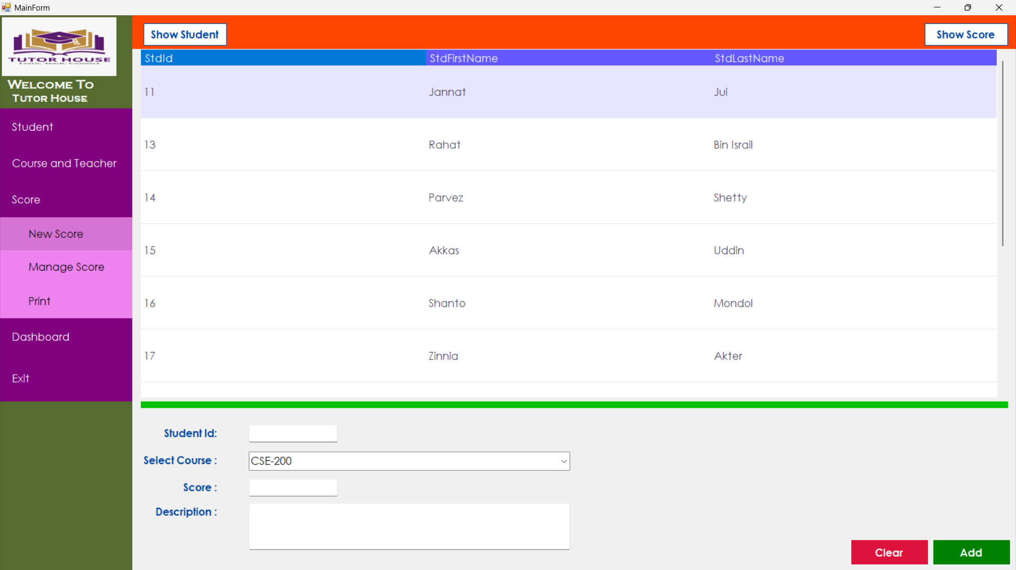
New Score

Slide 17
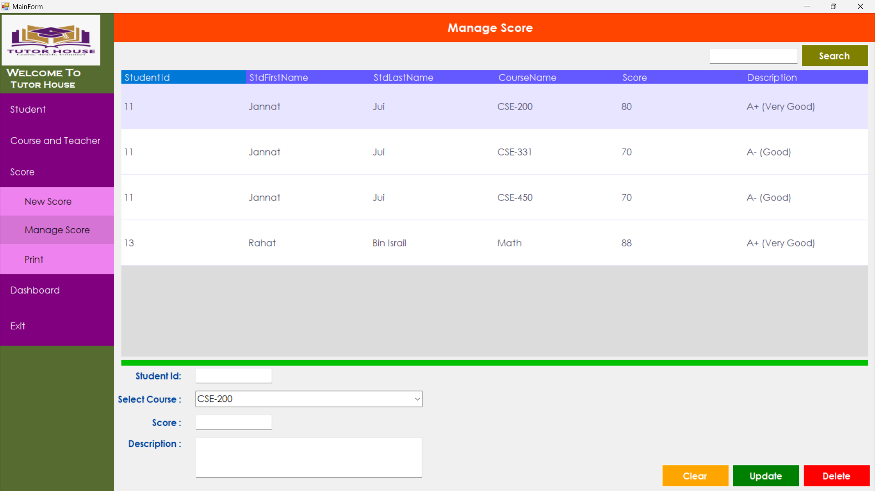
Manage Score

Slide 18
LIMITATION
Manual Input Dependency: All tasks, including user registration and control over panels, are dependent on manual input by the admin. This can be time-consuming and inefficient, especially as the system scales up with more users.
Limited Autonomy for Users: Teachers and students cannot sign up independently, nor do they have control over their respective panels.
Limited Functionality: By restricting user capabilities to admin-controlled actions only, you limit the potential functionality and flexibility of the system.

Slide 19
Administrative Overload: With all tasks being managed manually by the admin, there's a risk of administrative overload, especially as the number of users and tasks increases. This could lead to delays, errors,
Scalability Concerns: As the system grows with more users, courses, and activities, relying solely on manual input and admin control may not be sustainable.

Slide 20
FUTURE WORK
To enhance the professionalism and effectiveness of the Tutoring Management System project in the future, consider implementing the following ideas:
Enhanced User Interface: Update the user interface to be more intuitive, visually appealing, and user-friendly. Incorporate modern design principles to improve user experience and engagement.
Mobile Application: Develop a mobile application version of the system to allow users to access tutoring services on-the-go. This will increase accessibility and convenience for both tutors and students.

Slide 21
Integration with Learning Management Systems: Integrate the Tutoring Management System with popular Learning Management Systems (LMS) to streamline data sharing, scheduling, and progress tracking for a more cohesive educational experience.
AI-Powered Recommendations: Implement artificial intelligence algorithms to provide personalized tutor recommendations based on student learning styles, preferences, and performance data.
Virtual Tutoring Features: Introduce virtual tutoring capabilities such as video conferencing, virtual whiteboards, and screen sharing to facilitate remote tutoring sessions and enhance collaboration between tutors and students.
Data Analytics and Reporting: Incorporate advanced data analytics tools to generate insights on tutoring effectiveness, student progress, and areas for improvement. Develop customizable reports for administrators, tutors, and students

Slide 22
Gamification Elements: Introduce gamification elements such as badges, rewards, and progress tracking to motivate student engagement and participation in tutoring sessions.
Feedback and Rating System: Implement a feedback and rating system to gather input from students on tutor performance, session quality, and overall satisfaction. Use this data to continuously improve the tutoring experience.
Integration with Payment Gateways: Enable seamless payment processing within the system for tutoring services, allowing for secure transactions and automated invoicing.
Teacher & Student Singup : Teacher & Student can be Singup separately & handle there information, course by own.

Slide 23
CONCLUSION
The Tutoring Center Management System represents a significant advancement in the field of educational management software. By automating routine tasks, optimizing resource allocation, and providing valuable insights, TCMS empowers tutoring centers to operate more efficiently and effectively. With its array of features and user-friendly interface, TCMS is poised to revolutionize the way tutoring centers manage their operations, ultimately enhancing the educational experience for students.

